Slide 1
Capstone Project- Real Estate
Linear Regression
R.M.L.Sulochana Rathnayake
Reg No:212

Slide 2
Introduction
In this project developed and analyzed a machine learning model to predict the house price of a unit area based on given parameters such as house age, distance to the nearest MRT station, number of convenience stores so on.
Linear Regression method has been used to build the model.
Data set Reference: https://www.kaggle.com/code/christianjericson/classroom-experiment-1/data
In Machine Learning,
Linear Regression is a supervised machine learning algorithm.
It tries to find out the best linear relationship that describes the data we have.
It assumes that there exists a linear relationship between a dependent variable and independent variable(s).
The value of the dependent variable of a linear regression model is a continuous value i.e. real numbers.

Slide 3
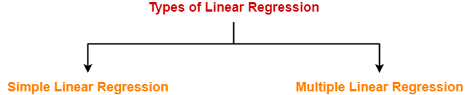
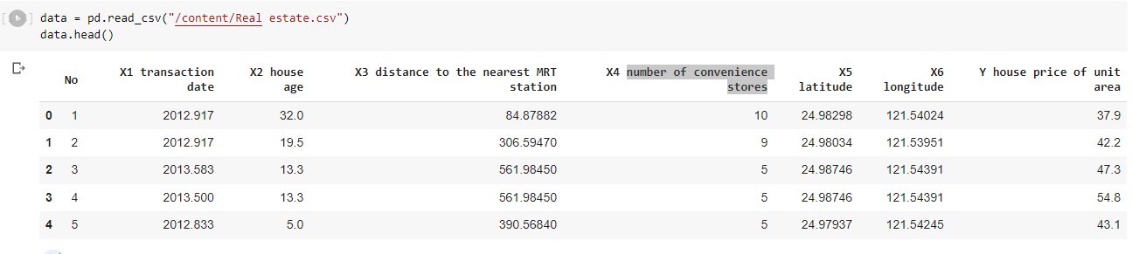
Types of Linear Regression-
Based on the number of independent variables, there are two types of linear regression-
Multiple linear regression, the dependent variable depends on more than one independent variables. This project is belonging to this category as the unit price is depend on multiple independent variables.
Project Execution Steps
- Prepare Dataset
As the first step, load the data set to the google colab repository and check the available data.

Slide 4

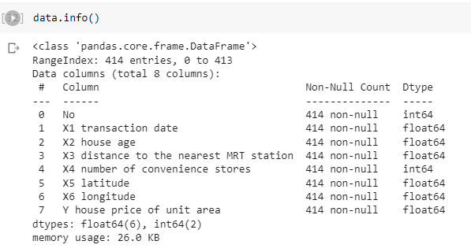
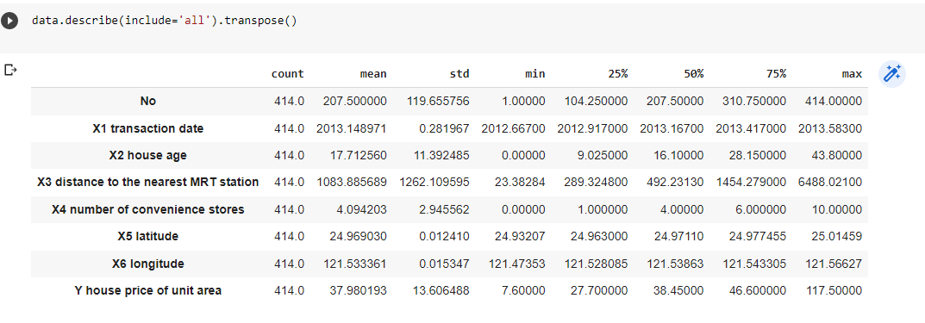
- Exploring Data
Then check the total No of rows and the columns available in the data set, data types, No of missing values in each columns and the memory usage. This is very useful to get the overall idea on the available data.
- Then analyze the data distribution range

Slide 5
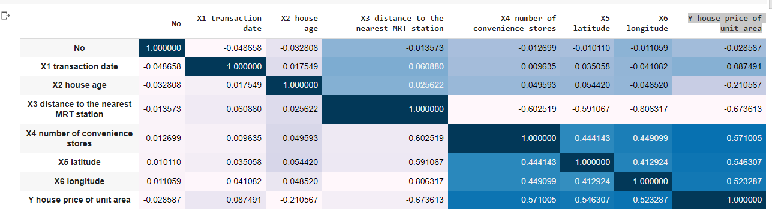
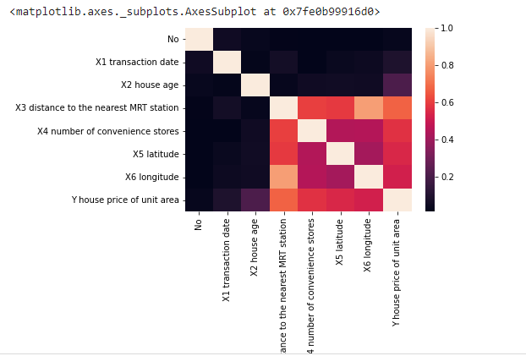
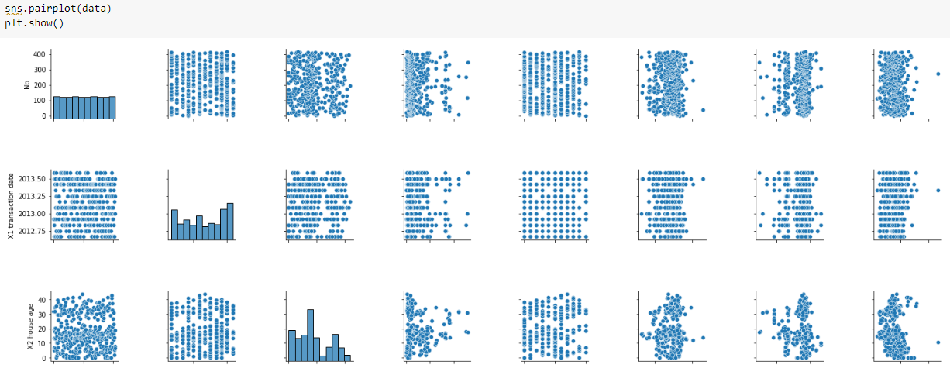
- Correlation Analysis
Analysis of correlation between variables
- Heat map analysis and the pairplot also provide the clear idea about the relation between variables.

Slide 6
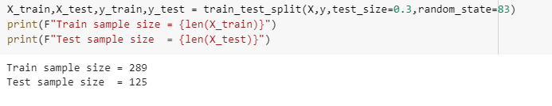

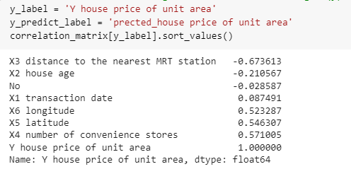
- Defining X and Y variables
- Divide the data set in to two sections as “test” and “train” data. Here I have used 0.3% as test sample and 0.7% as the train sample
- Create Linear Regression model object.
- Select The Feature with Highest Correlation With Target (y)

Slide 7
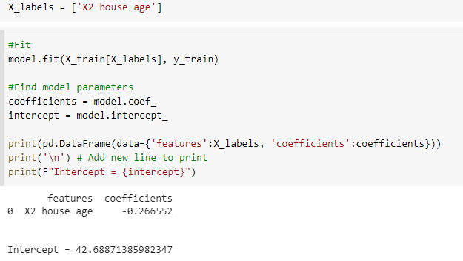
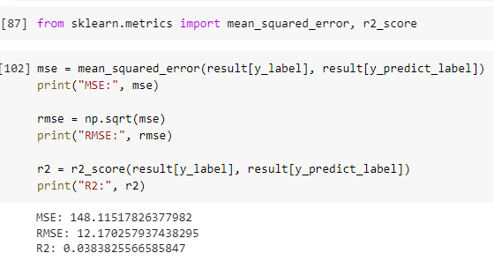
- Train Model
Train Model with One Variable.
Here I used “house age” variable as the first variable to trin the model
- Evaluate the Model
- Evaluate the model after train the model

Slide 8

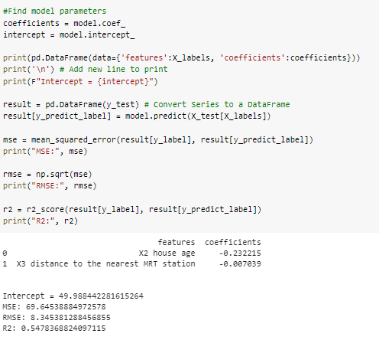
- Improve Model (2nd Iteration)
Train Model with multiple variables and check the performance
- Evaluate the Model
- Evaluate the model after train the model
- Likewise can check the model performance by combining multiple variables

Slide 9
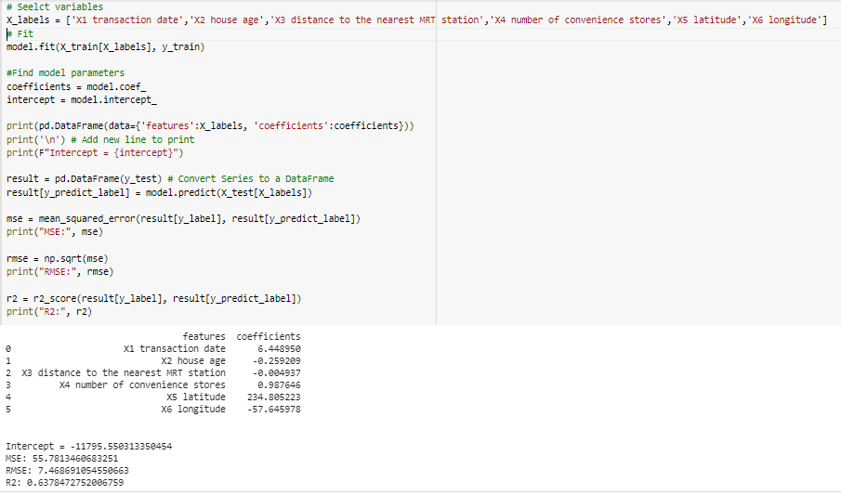
- Improve Model (Final Iteration)
Train Model with all variables and check the performance.

Slide 10
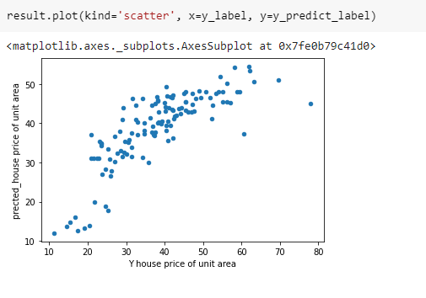
- Tracking Model Evaluation Results
- Predicted vs. Actual

Slide 11
Thank You

